Slide 1
IMC Analysis – Chordoma (CH)

Slide 2
Dataset
15 patients, 11 cores per patient (165 cores on the TMA)
152 cores acquired on the Hyperion; 13 not acquired, most of them core 11
Panel of 37 markers (35 antibodies + 2 DNA channels)
~170,000 cells after segmentation
Six sample types per patient, from high-grade tumour to non-neoplastic tissue

Slide 3
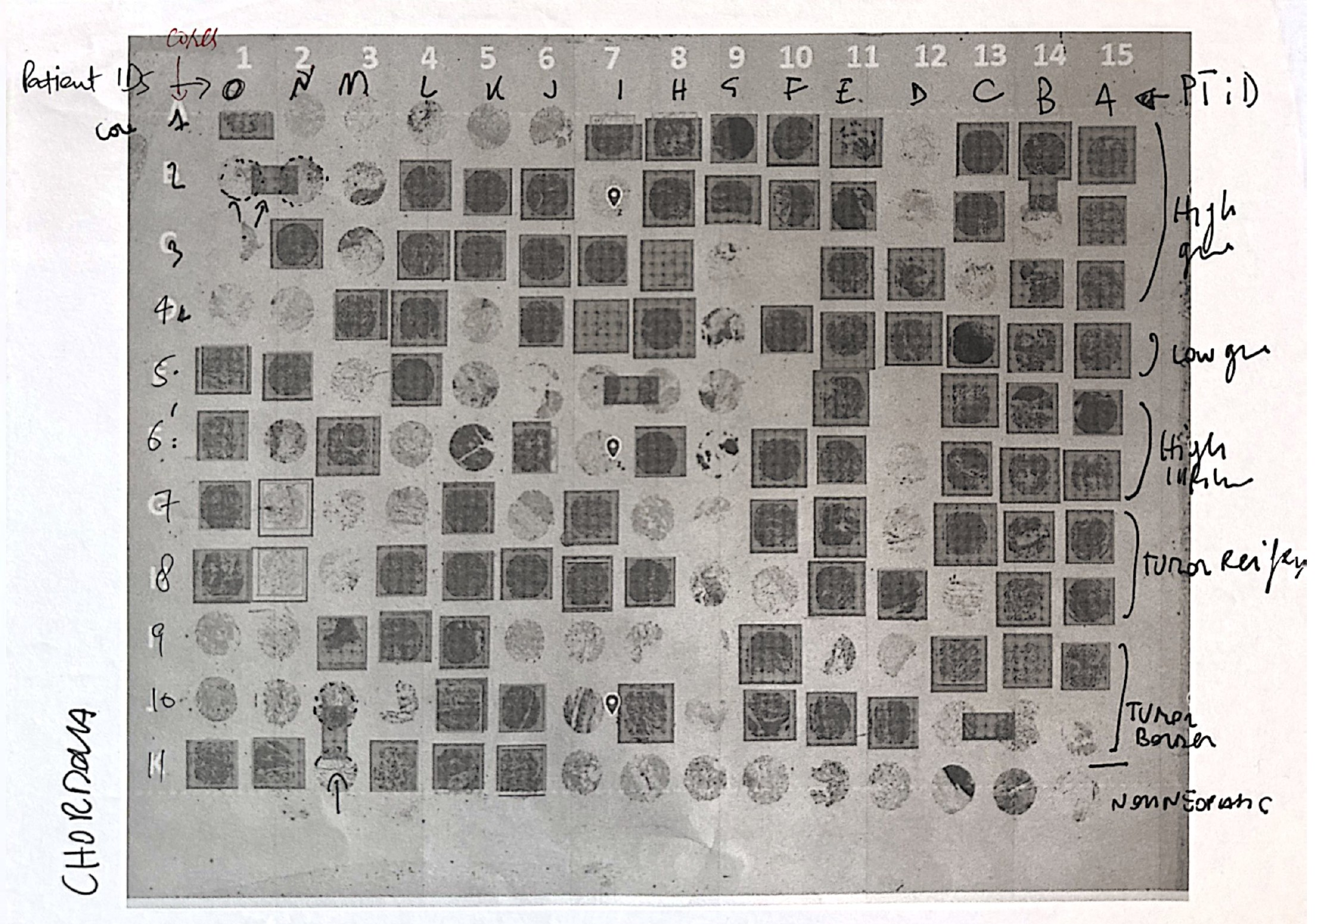
TMA reference sheet
Annotated print of the CH slide
Patient IDs A-O across the top, A on the right
Cores 1-11 down the side
Brackets on the right give the sample type

Slide 4
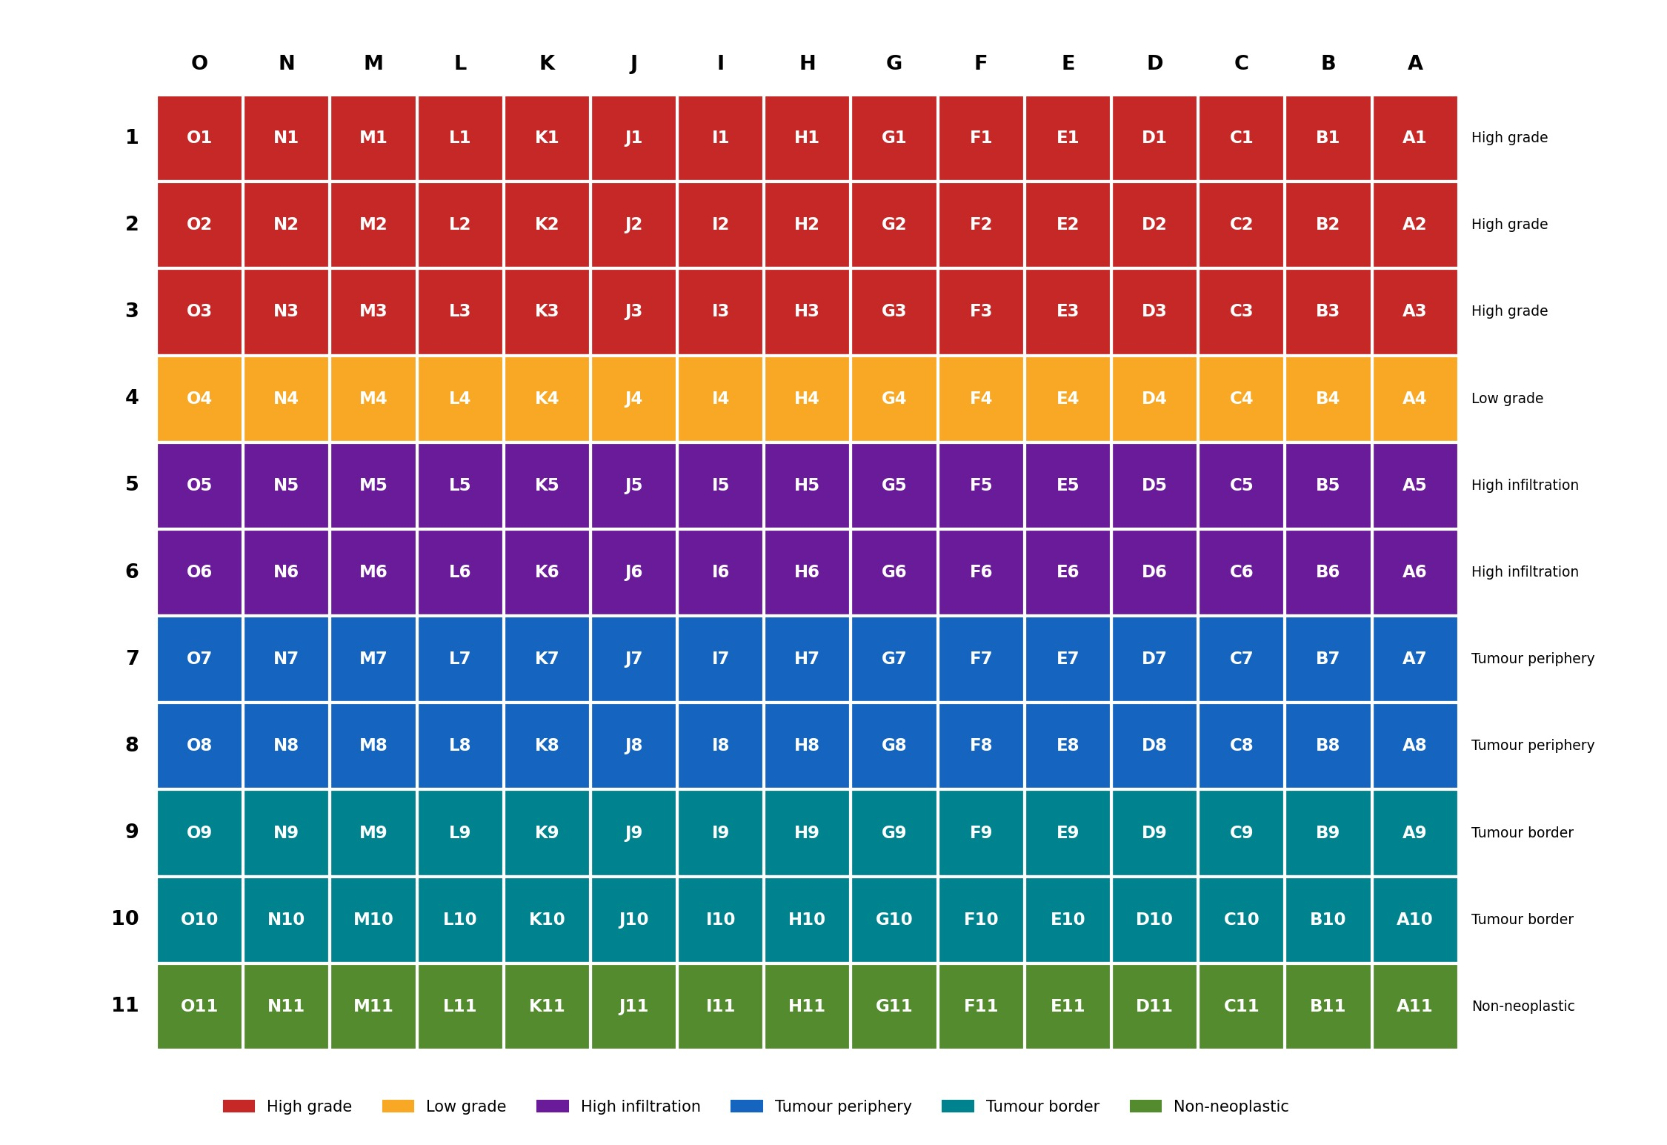
TMA layout
Columns = patients (A-O), rows = cores 1-11
Core 1-3 high grade, 4 low grade, 5-6 high infiltration, 7-8 tumour periphery, 9-10 tumour border, 11 non-neoplastic
13 cores not acquired: core 11 of A-I and M, plus D5, F3, F5

Slide 5
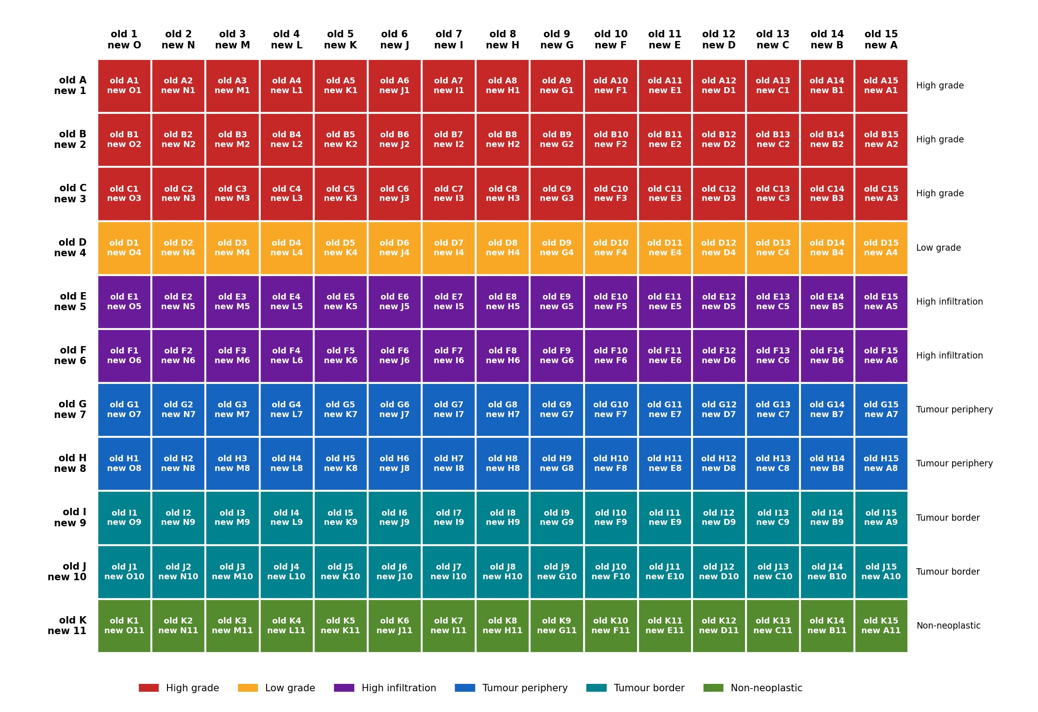
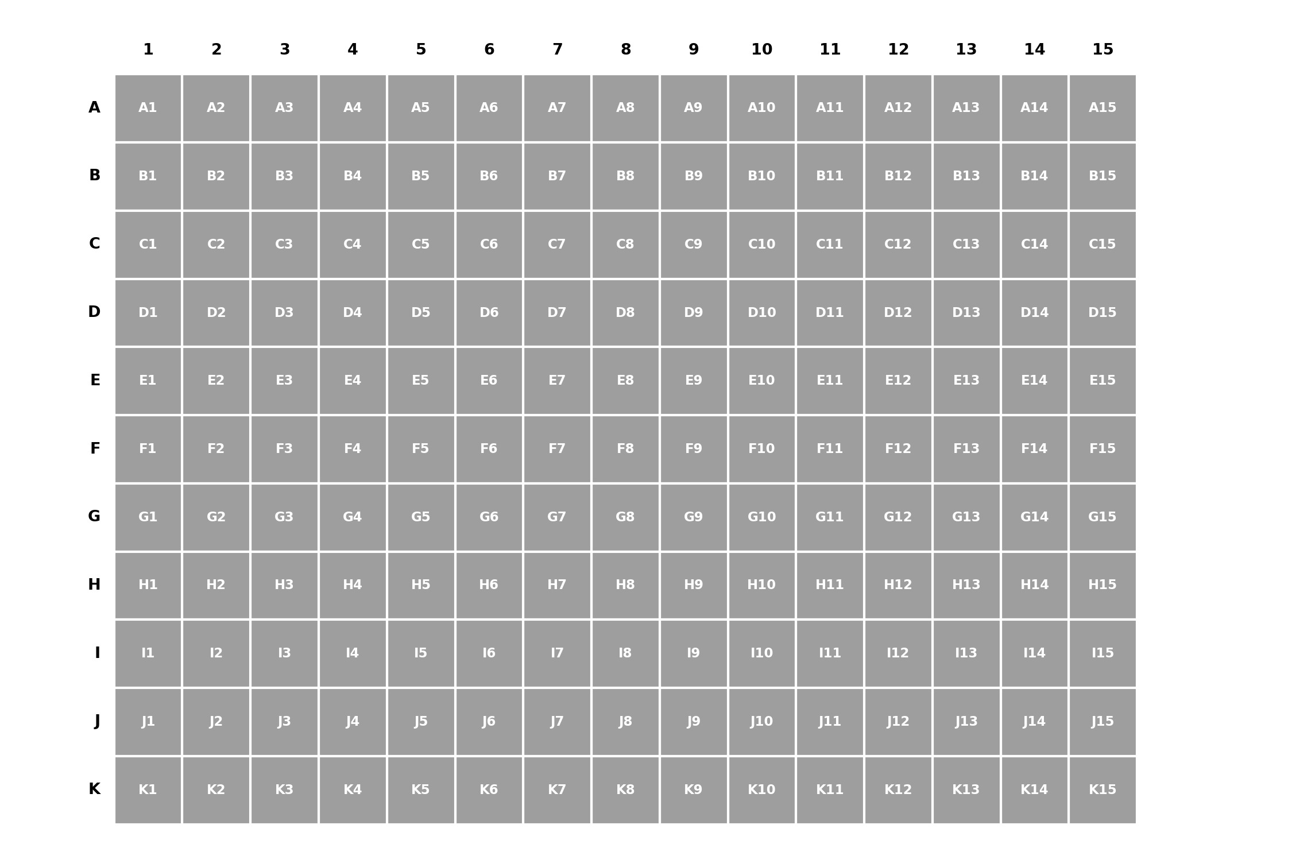
Slide positions vs key labels
Positions printed on the slide (used in the ROI names)
Same cores with both labels
ROI files are named by slide position (ROI013_F11), all files renamed to key labels (ROI013_E6

Slide 6
Workflow
Raw data read from CH.mcd (not from the exported TIFFs)
Hot pixel removal (steinbock rule, threshold 50 counts)
Cell segmentation with Cellpose (cpsam)
  nuclear channel: DNA1, DNA2, Brachyury
  membrane channel: S100, CD68, aSMA, CD31, CD3, CD66b
Single-cell measurements with Steinbock (intensities, shape, neighbours)
QC per core, then annotation with patient and sample type

Slide 7
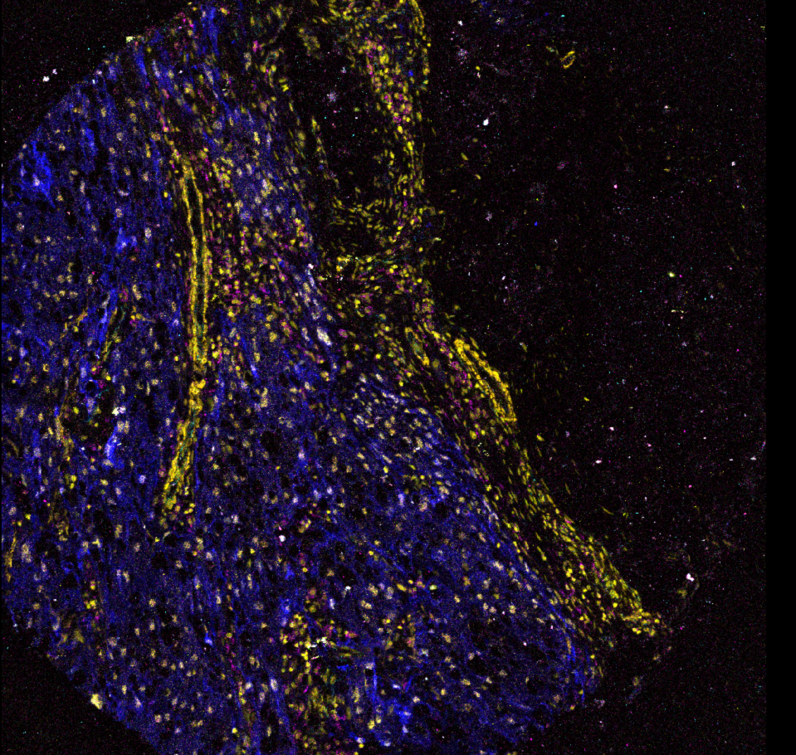
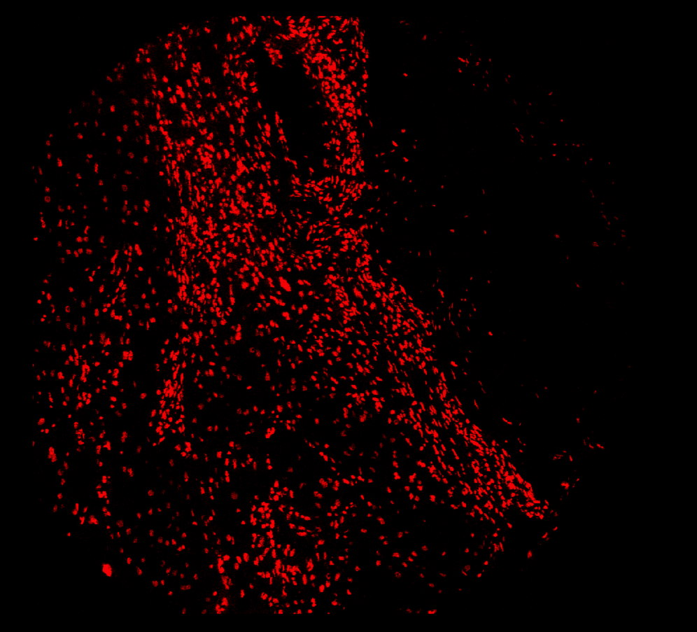
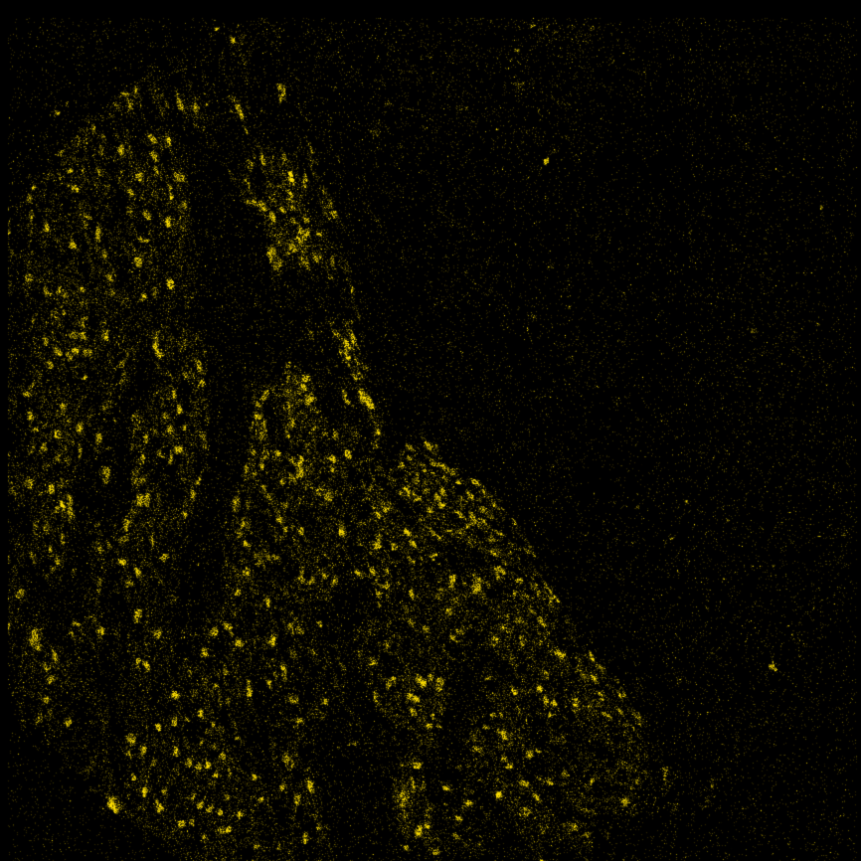
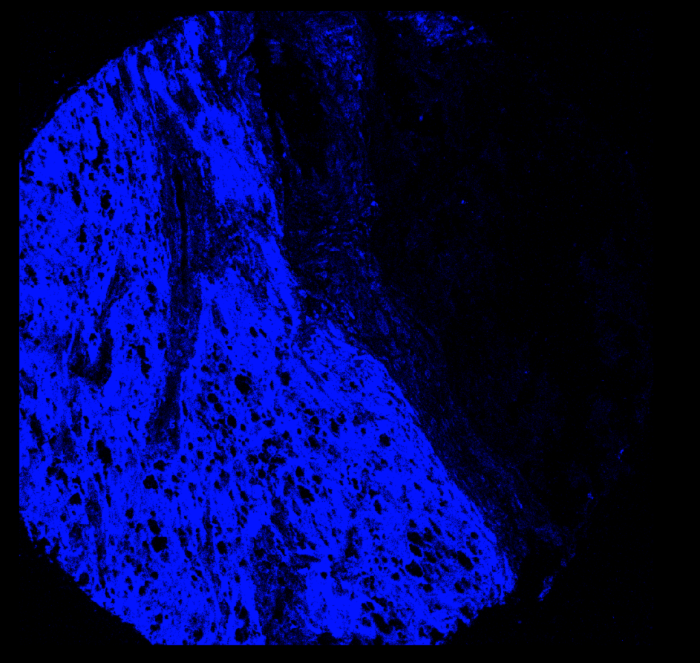
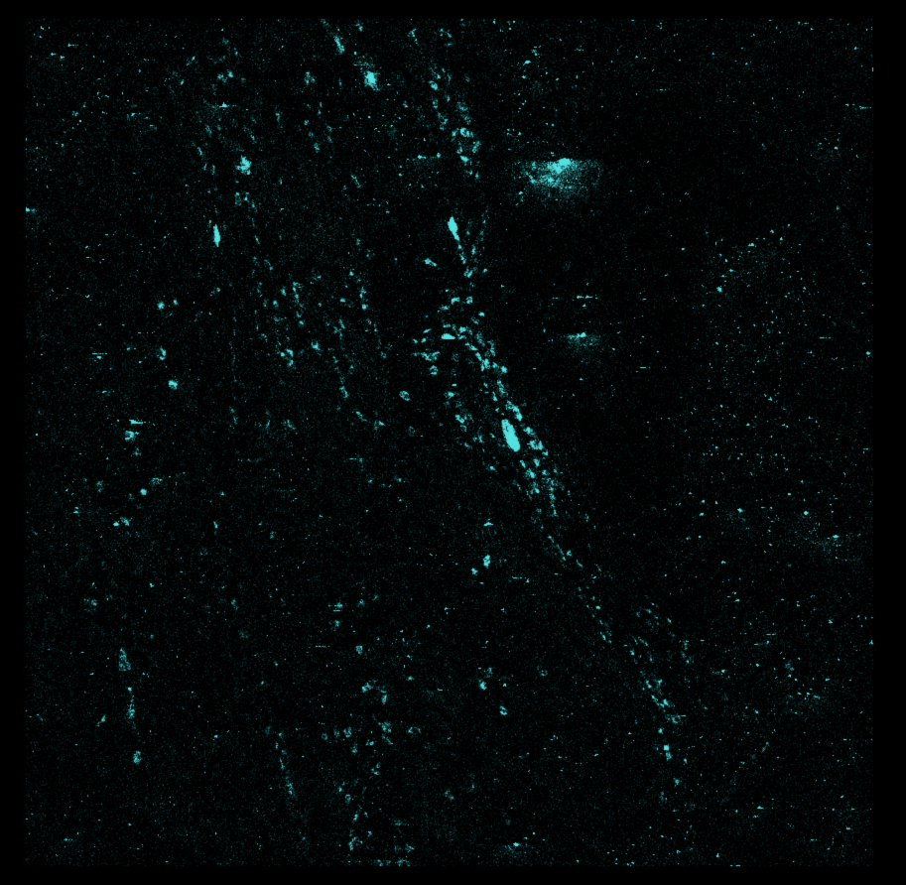
Example core (K9, tumour border)
All channels
DNA1
Brachyury
DNA in the nuclei
Brachyury in tumour cell nuclei
S100 over the tumour area
CD68+ macrophages scattered
S100
CD68
Core K9, 1000 x 1000 µm. QuPath snapshots.

Slide 8
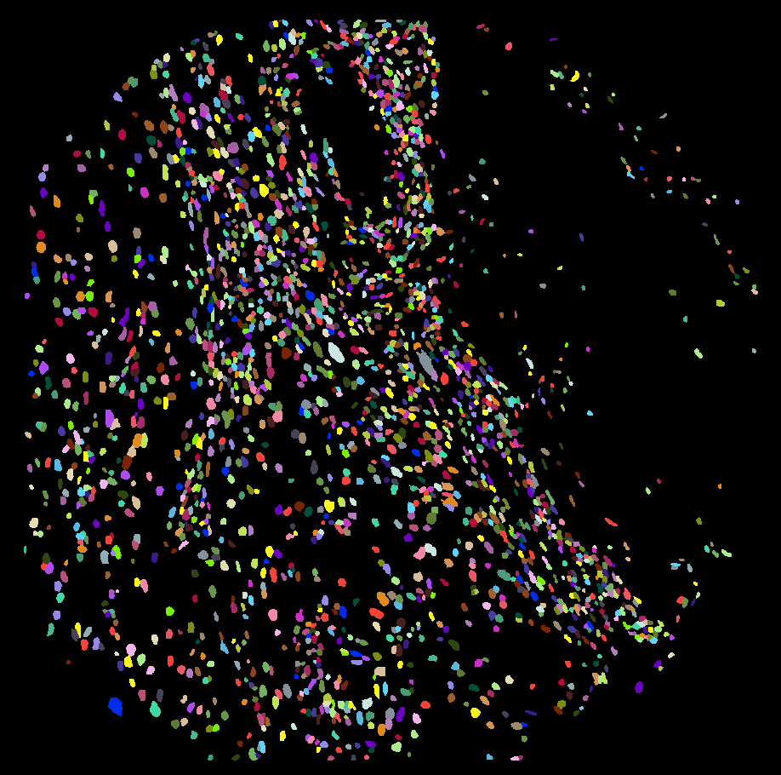
Segmentation
169,708 cells in 152 cores
Median 1,046 cells per core
Fewer cells in the non-neoplastic cores
K9, Cellpose segmentation, 2,227 cells (each colour = one cell), napari snapshot

Slide 9
Marker intensity by sample type
 | Brachy | S100 | Ki67 | CD68 | CD163 | CD11c | HLA-DR | CD3 | CD4 | CD8 | CD66b | CD31 | aSMA | PDL1
High grade | 1.43 | 2.00 | 0.11 | 0.65 | 0.43 | 0.15 | 0.28 | 0.18 | 0.47 | 0.35 | 0.18 | 0.29 | 0.79 | 0.37
Low grade | 1.46 | 1.91 | 0.12 | 0.72 | 0.47 | 0.14 | 0.32 | 0.18 | 0.48 | 0.36 | 0.14 | 0.32 | 0.82 | 0.40
High infiltration | 1.18 | 1.56 | 0.12 | 0.69 | 0.50 | 0.18 | 0.33 | 0.21 | 0.55 | 0.41 | 0.17 | 0.32 | 0.94 | 0.39
Tumour periphery | 0.73 | 1.55 | 0.08 | 0.63 | 0.47 | 0.13 | 0.31 | 0.17 | 0.46 | 0.32 | 0.17 | 0.31 | 1.10 | 0.34
Tumour border | 0.18 | 1.17 | 0.07 | 0.49 | 0.43 | 0.14 | 0.27 | 0.16 | 0.42 | 0.28 | 0.19 | 0.31 | 1.48 | 0.31
Non-neoplastic | 0.08 | 0.74 | 0.06 | 0.33 | 0.28 | 0.07 | 0.18 | 0.11 | 0.29 | 0.30 | 0.13 | 0.25 | 1.31 | 0.30
Brachyury goes down from tumour to border to normal tissue
CD3, CD4, CD8, CD163 and CD11c highest in the high-infiltration cores
aSMA higher at the tumour border
No phenotyping yet
Mean arcsinh intensity per cell, DNA-valid cores only; colour scaled per marker (white = lowest, red = highest).

Slide 10
DNA signal per core
 | O | N | M | L | K | J | I | H | G | F | E | D | C | B | A
1 | O1 | N1 | M1 | L1 | K1 | J1 | I1 | H1 | G1 | F1 | E1 | D1 | C1 | B1 | A1
2 | O2 | N2 | M2 | L2 | K2 | J2 | I2 | H2 | G2 | F2 | E2 | D2 | C2 | B2 | A2
3 | O3 | N3 | M3 | L3 | K3 | J3 | I3 | H3 | G3 |  | E3 | D3 | C3 | B3 | A3
4 | O4 | N4 | M4 | L4 | K4 | J4 | I4 | H4 | G4 | F4 | E4 | D4 | C4 | B4 | A4
5 | O5 | N5 | M5 | L5 | K5 | J5 | I5 | H5 | G5 |  | E5 |  | C5 | B5 | A5
6 | O6 | N6 | M6 | L6 | K6 | J6 | I6 | H6 | G6 | F6 | E6 | D6 | C6 | B6 | A6
7 | O7 | N7 | M7 | L7 | K7 | J7 | I7 | H7 | G7 | F7 | E7 | D7 | C7 | B7 | A7
8 | O8 | N8 | M8 | L8 | K8 | J8 | I8 | H8 | G8 | F8 | E8 | D8 | C8 | B8 | A8
9 | O9 | N9 | M9 | L9 | K9 | J9 | I9 | H9 | G9 | F9 | E9 | D9 | C9 | B9 | A9
10 | O10 | N10 | M10 | L10 | K10 | J10 | I10 | H10 | G10 | F10 | E10 | D10 | C10 | B10 | A10
11 | O11 | N11 |  | L11 | K11 | J11
122 valid, 5 intermediate, 24 DNA-negative, 1 core without cells (L11)
Cell is DNA-negative if arcsinh(DNA1) + arcsinh(DNA2) < 1
Core is DNA-negative if > 50% of its cells are (valid < 20%)
Same criteria as for the chondrosarcoma TMA
Green valid, yellow intermediate, red DNA-negative, grey no cells, white not acquired

Slide 11
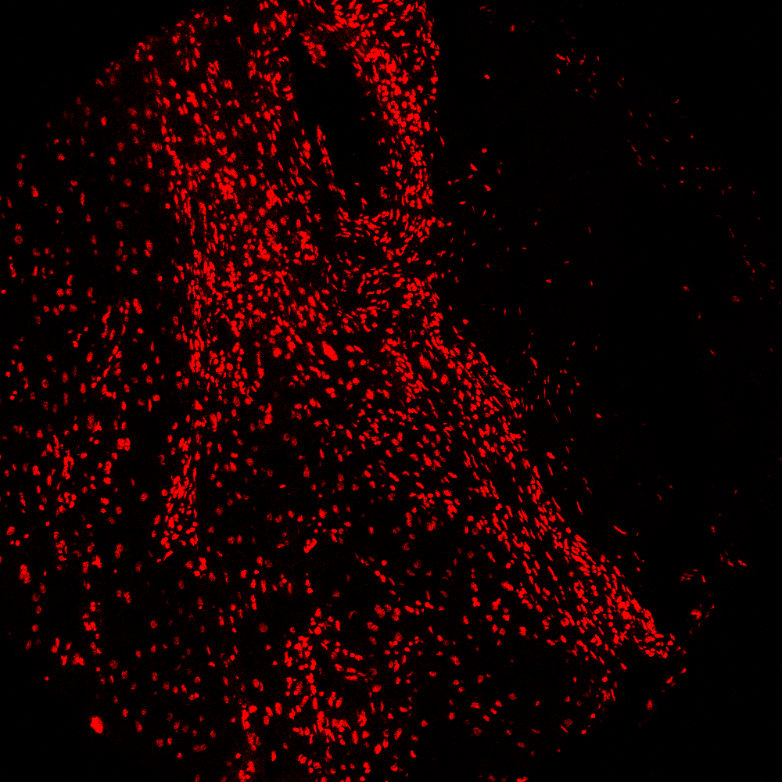

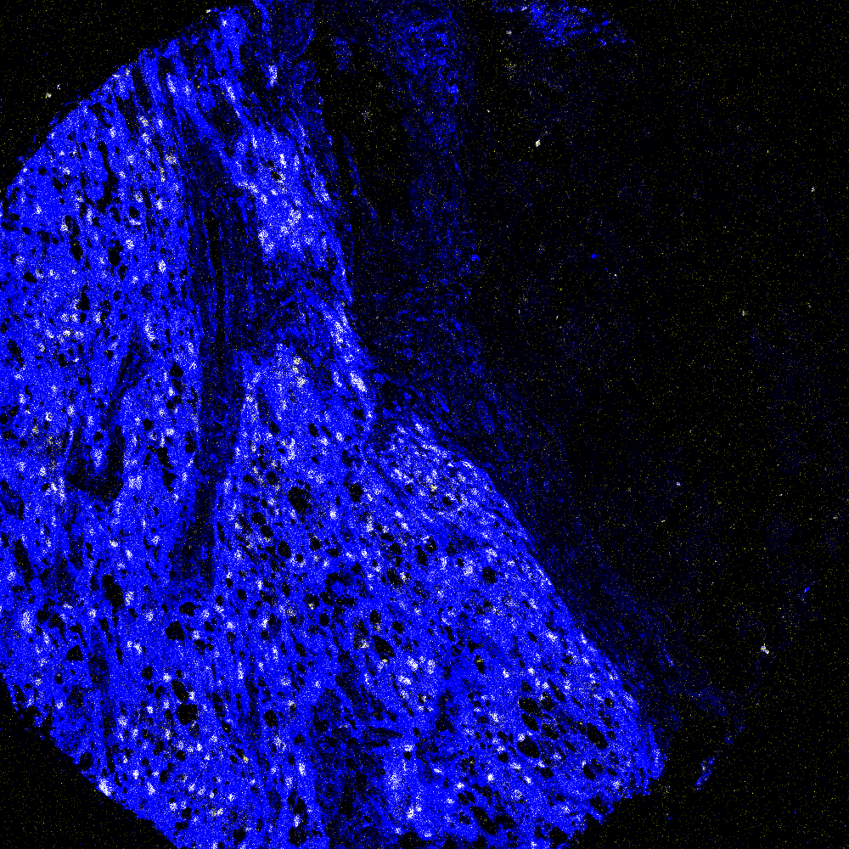
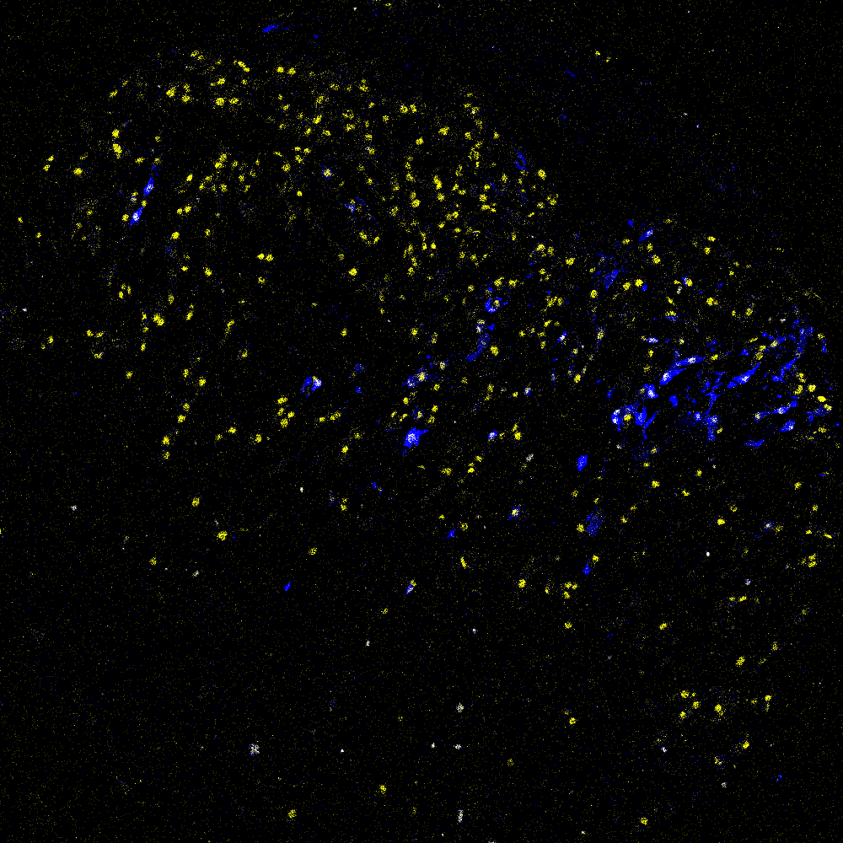
DNA-negative cores
K9 (valid)
E6 (DNA-negative)
DNA
DNA
S100 + Brachyury
S100 + Brachyury
18 of the 24 DNA-negative cores come from patient E (all 10 cores) and patient B (8 of 10)
E6 still shows tumour cells and Brachyury-positive nuclei, only the DNA (iridium) signal is missing (right: same display settings for both cores)

Slide 12
Summary
~170,000 cells from 152 cores of 15 chordoma patients
Every core linked to patient and sample type through the TMA key
Brachyury, S100 and immune markers follow the expected pattern across sample types
122 cores with good DNA signal; the DNA-negative cores are mostly from patients E and B

